Slide 1
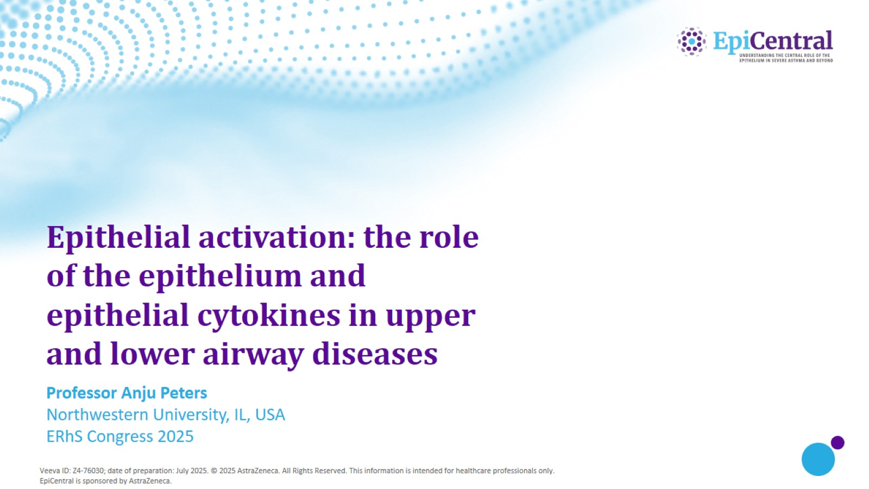
Epithelial activation: the role of the epithelium and epithelial cytokines in upper and lower airway diseases​

Slide 2
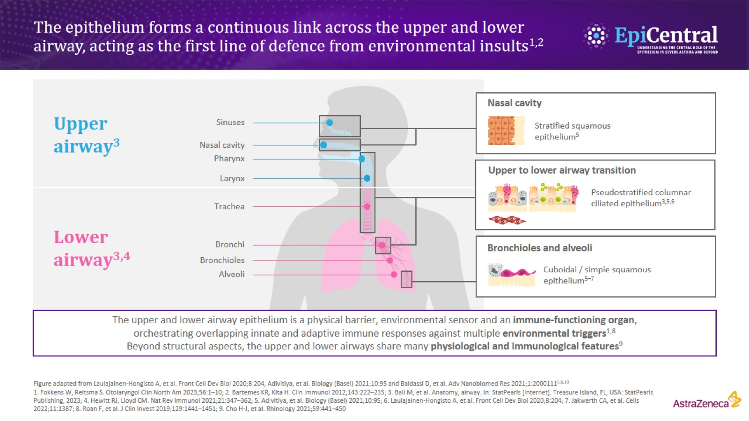
The epithelium forms a continuous link across the upper and lower airway, acting as the first line of defence from environmental insults^{1,2}

Slide 3
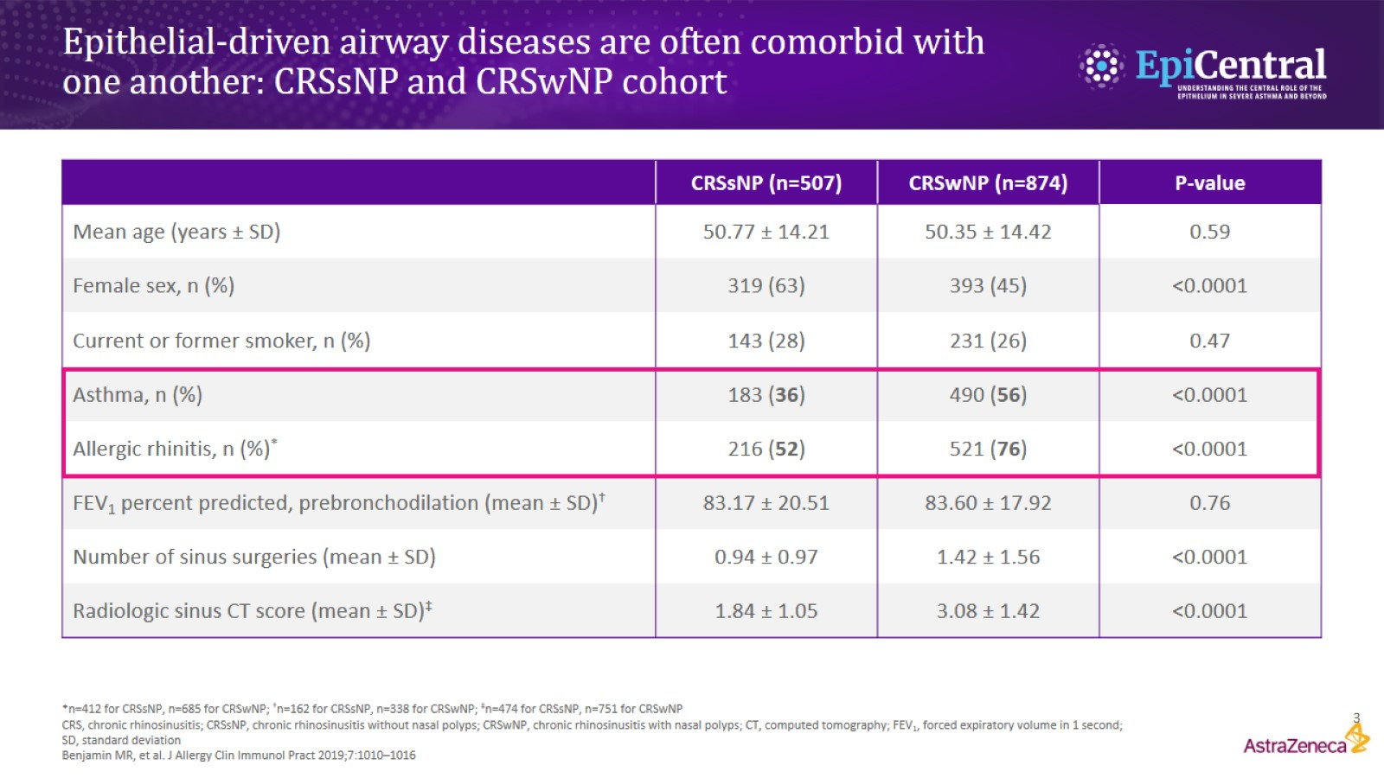
Epithelial-driven airway diseases are often comorbid with one another: CRSsNP and CRSwNP cohort

Slide 4
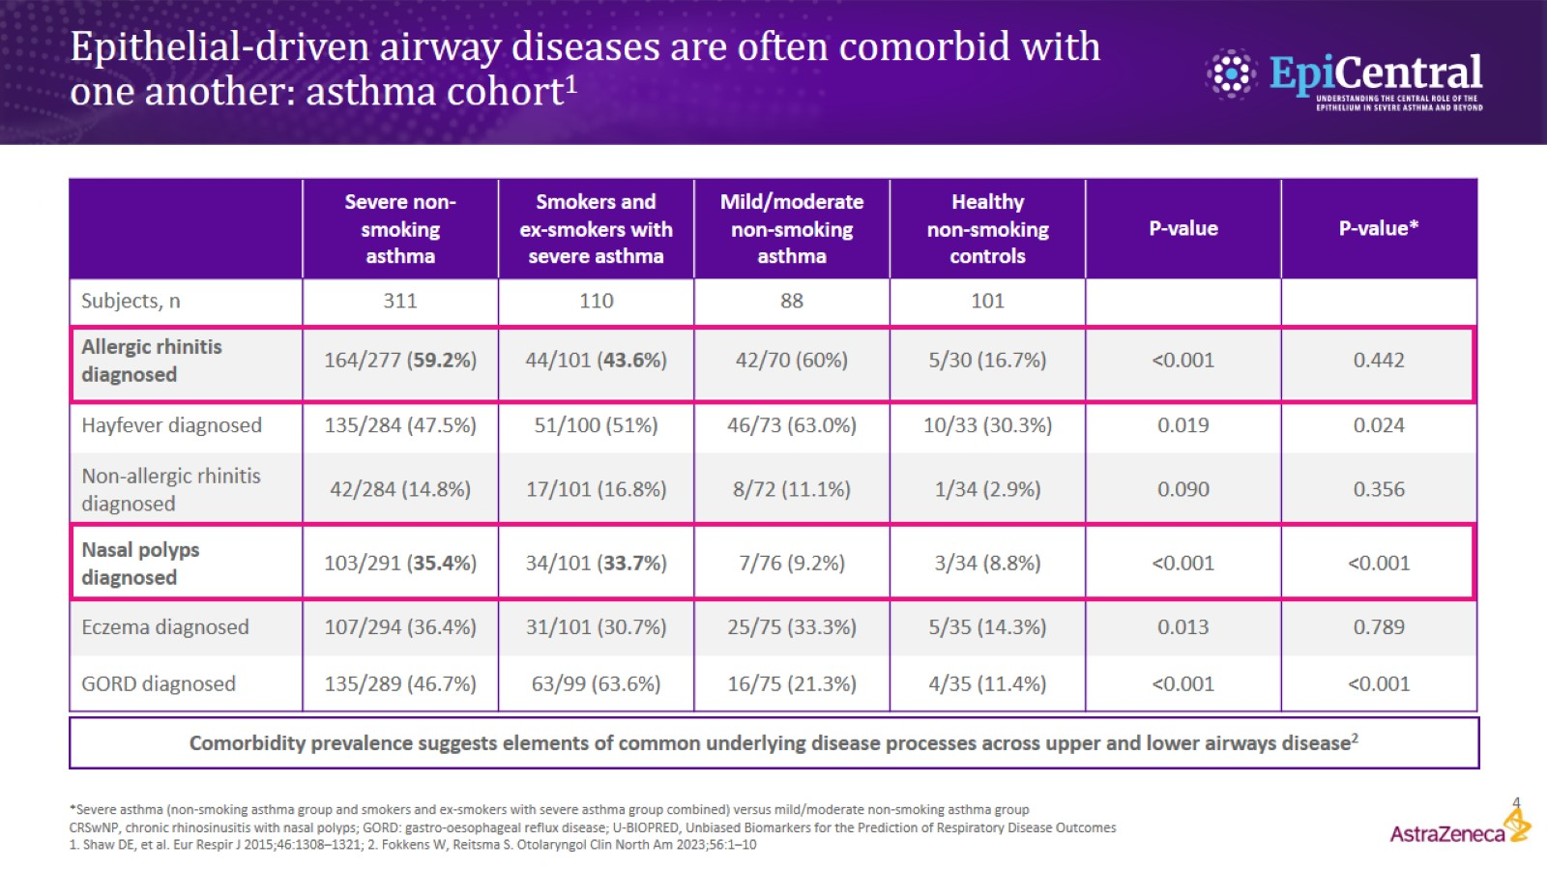
Epithelial-driven airway diseases are often comorbid with one another: asthma cohort¹

Slide 5
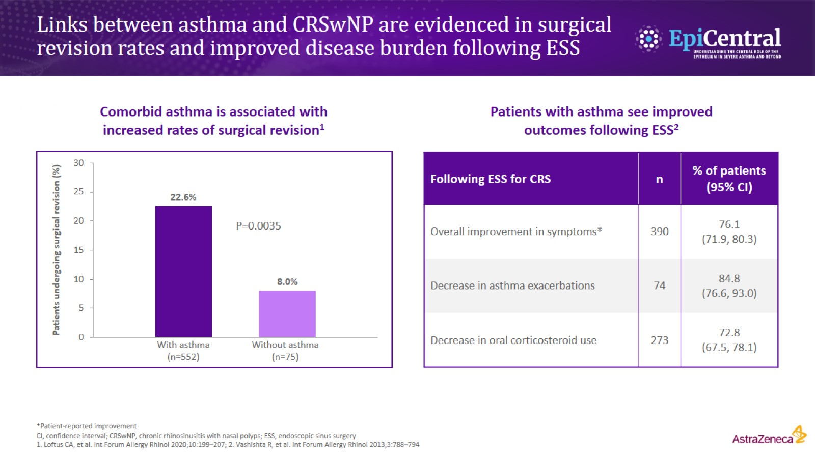
Links between asthma and CRSwNP are evidenced in surgical revision rates and improved disease burden following ESS

Slide 6
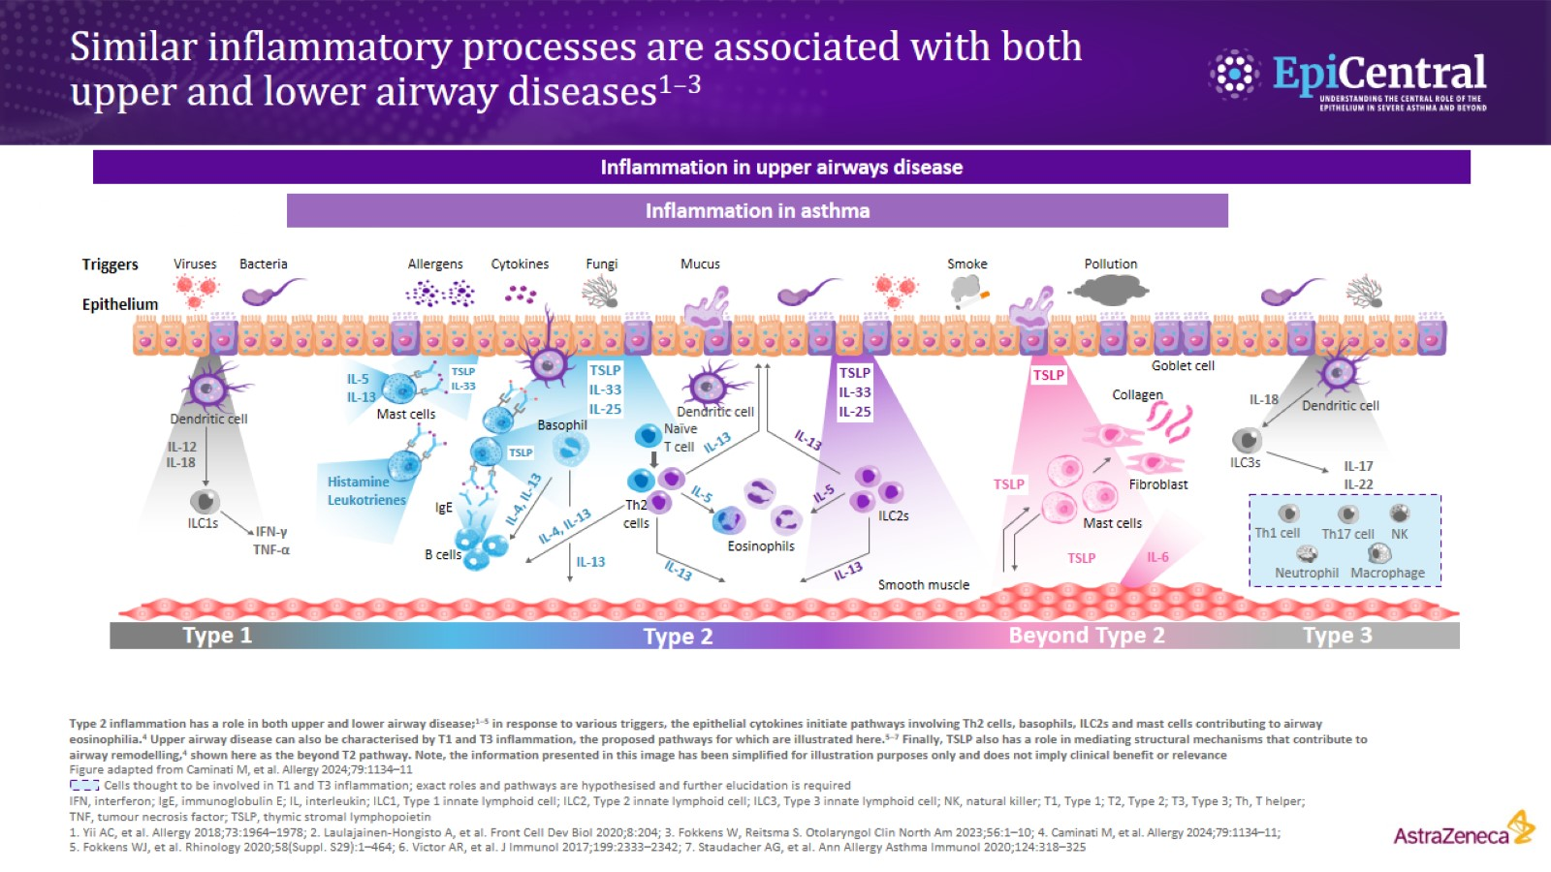
Similar inflammatory processes are associated with both upper and lower airway diseases^{1–3}

Slide 7
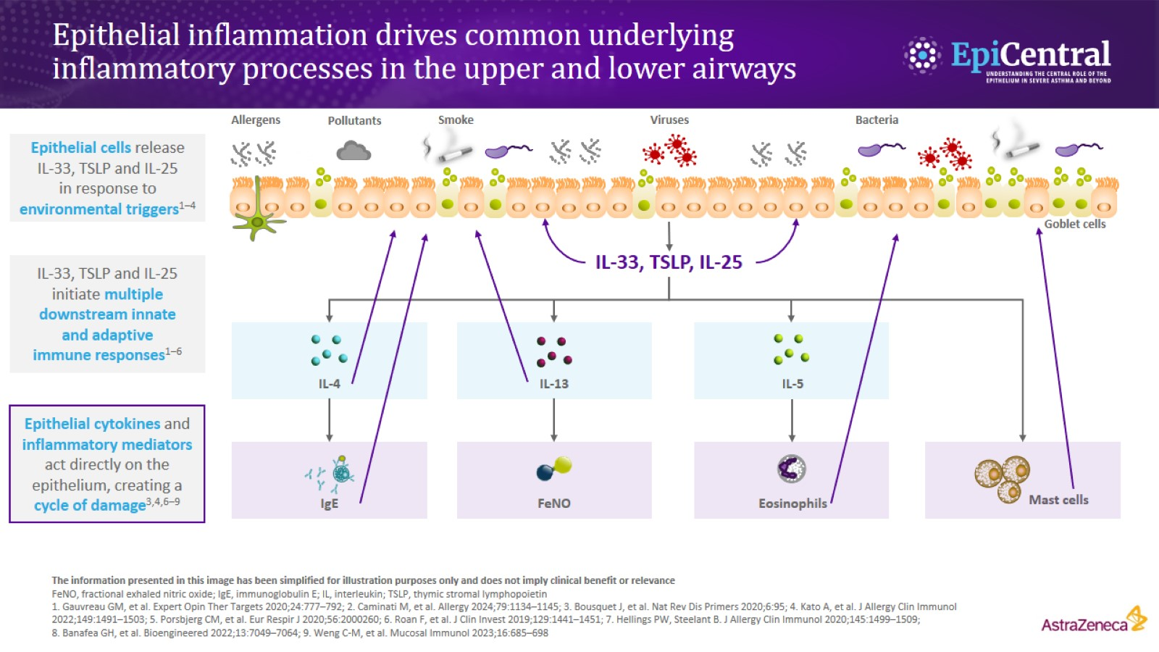
Epithelial inflammation drives common underlying inflammatory processes in the upper and lower airways

Slide 8
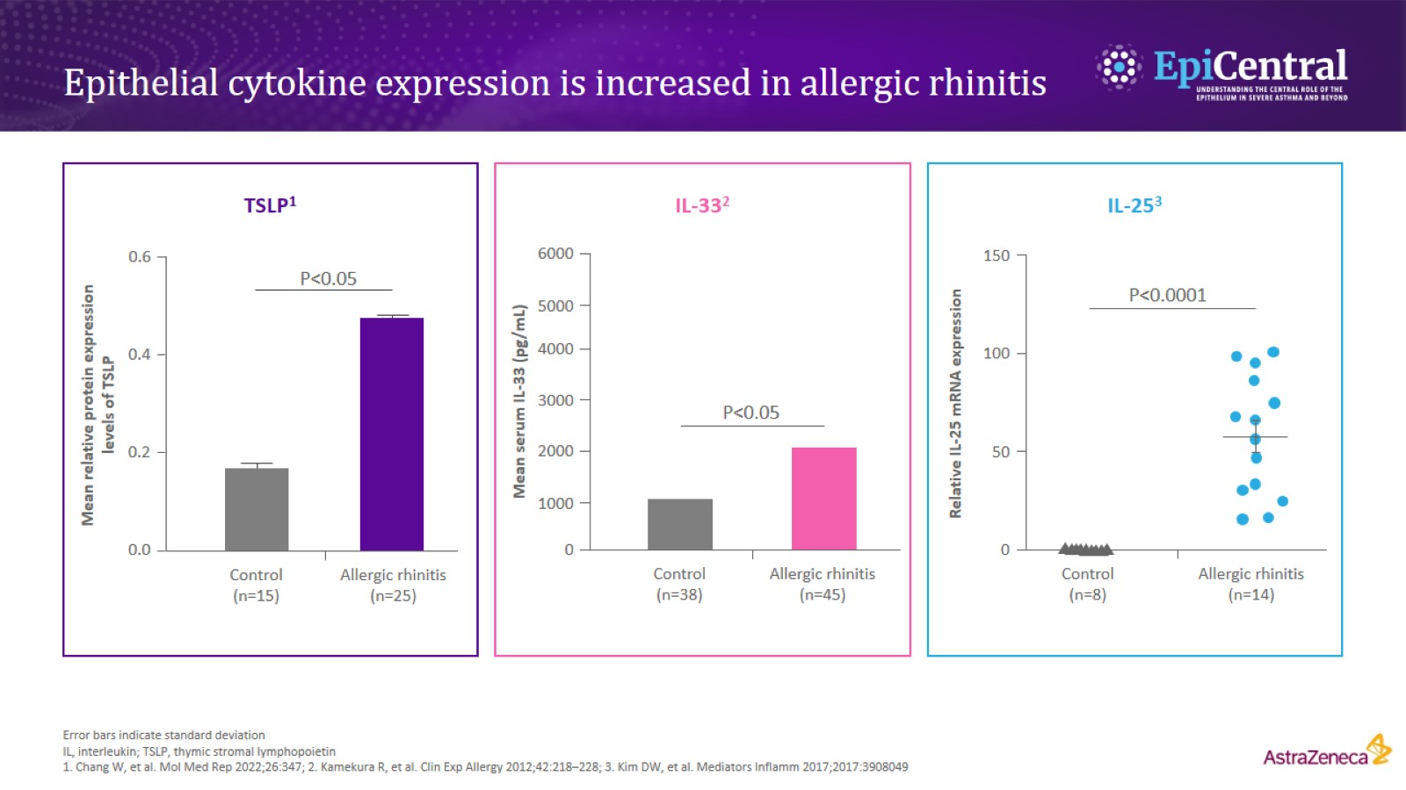
Epithelial cytokine expression is increased in allergic rhinitis

Slide 9
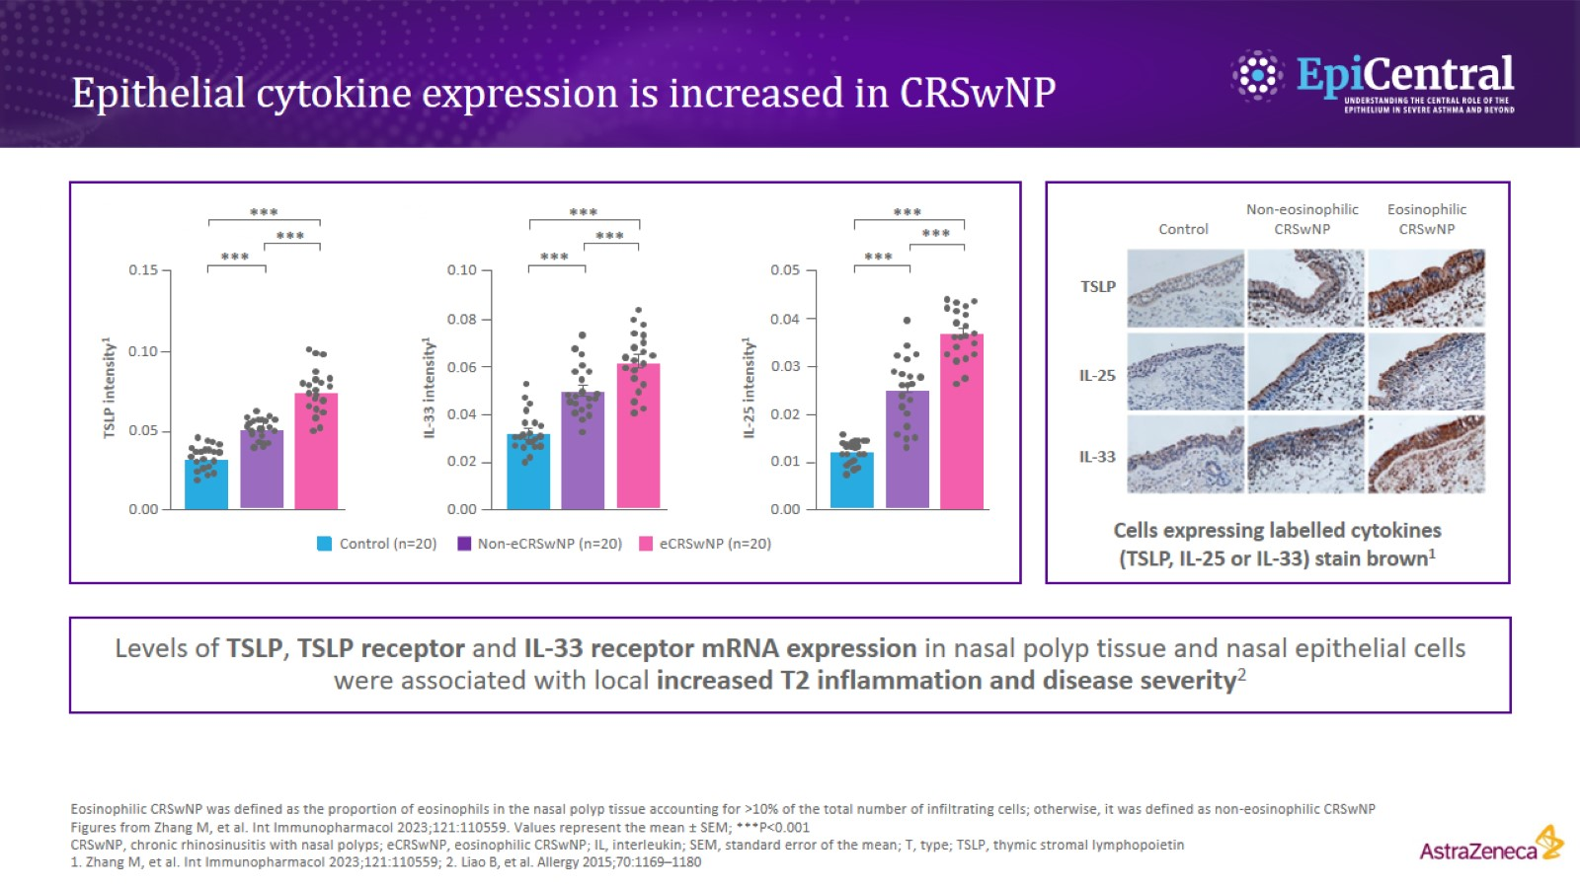
Epithelial cytokine expression is increased in CRSwNP

Slide 10
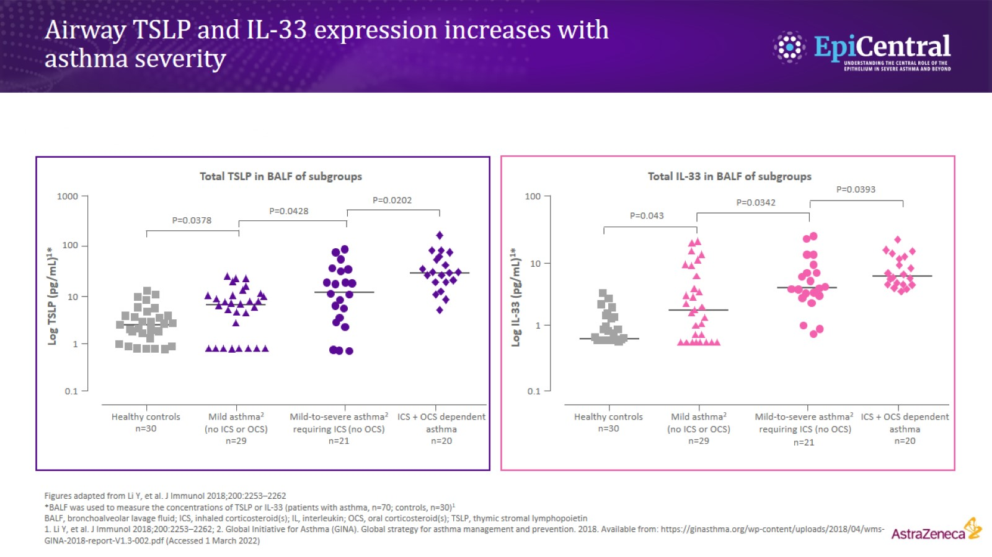
Airway TSLP and IL-33 expression increases with asthma severity

Slide 11
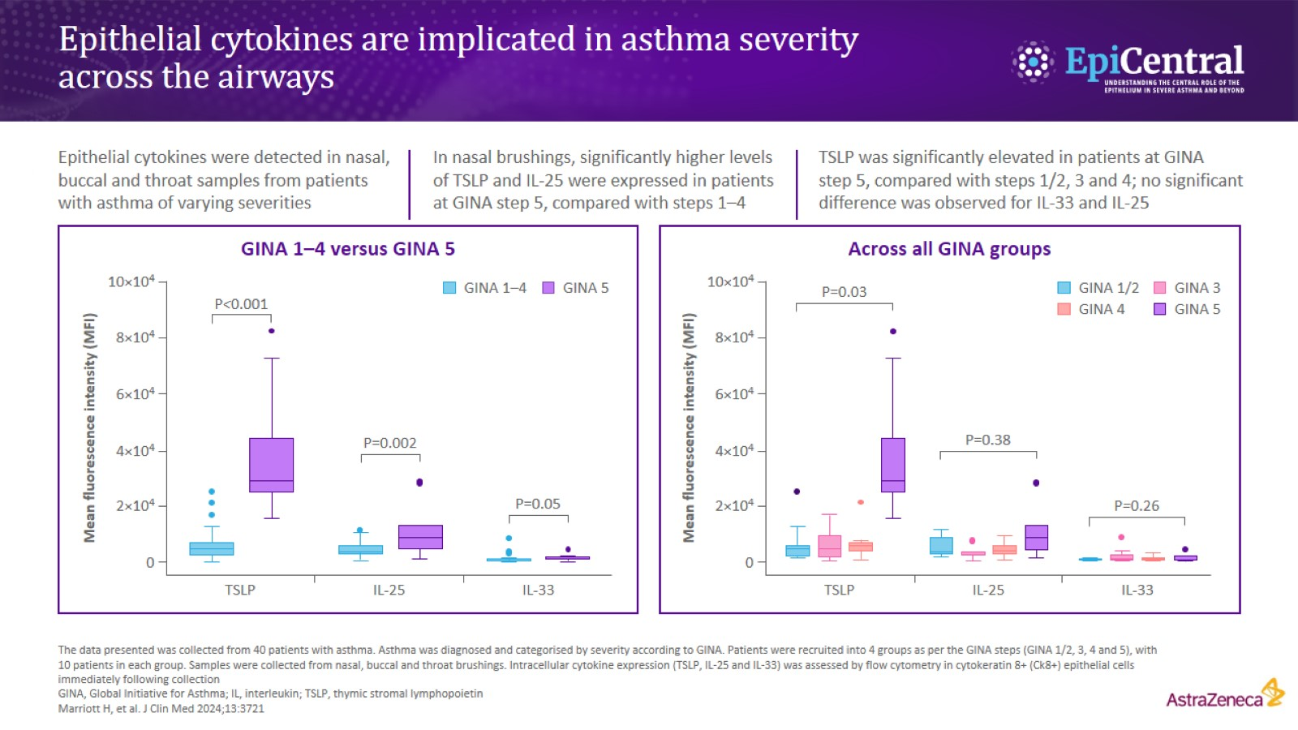
Epithelial cytokines are implicated in asthma severity across the airways

Slide 12
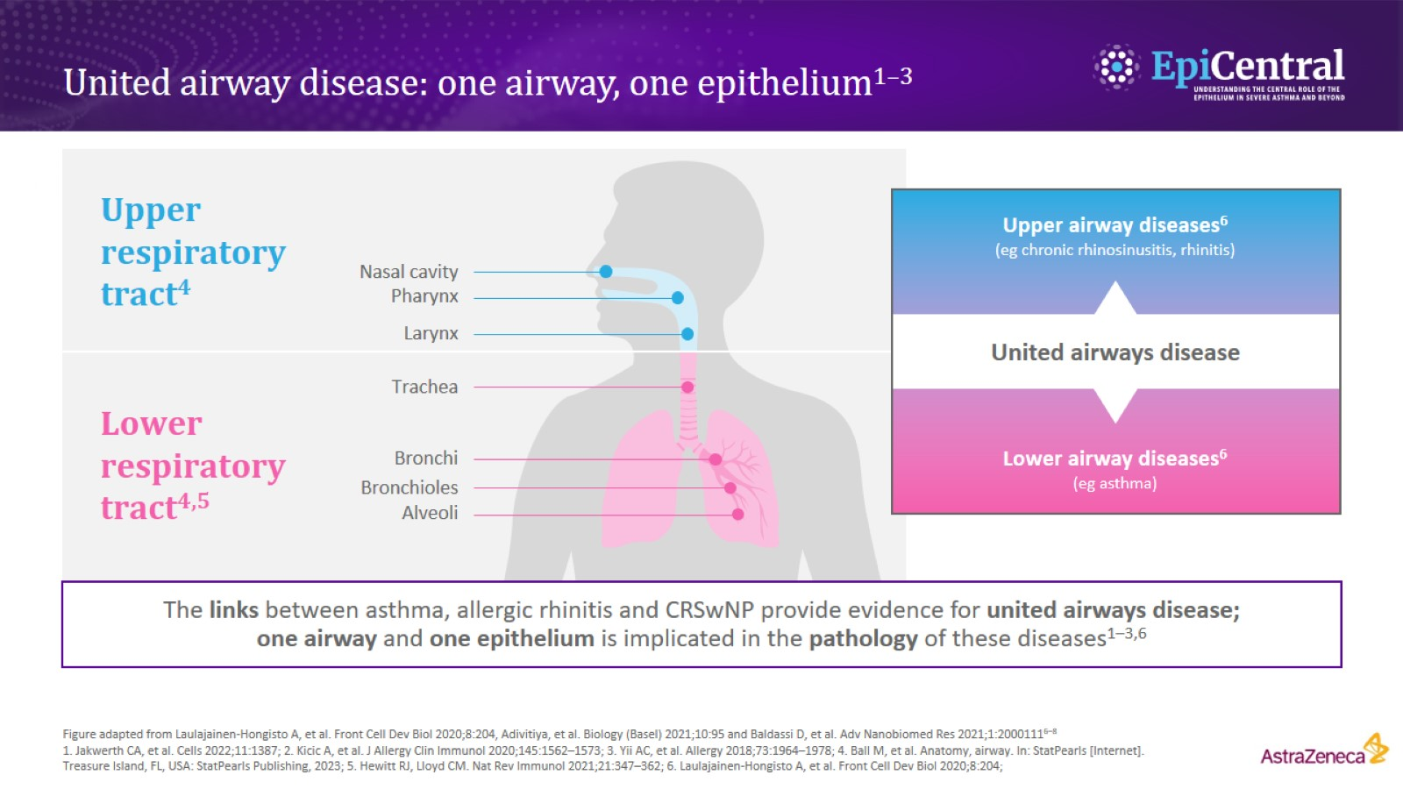
United airway disease: one airway, one epithelium^{1–3}

